Slide 1
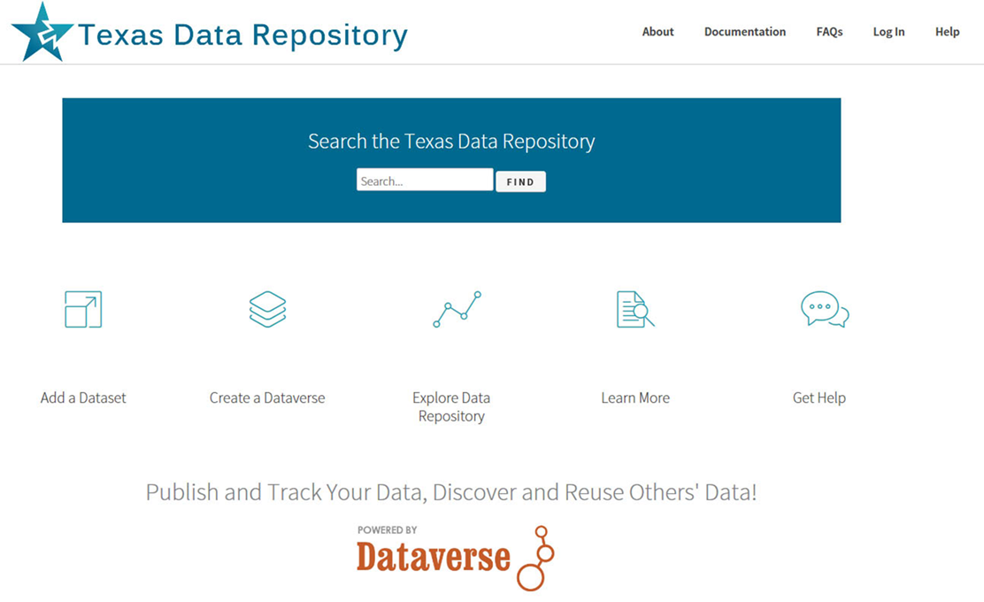
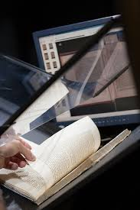
New Library Digital Initiatives for Research Faculty

Slide 2
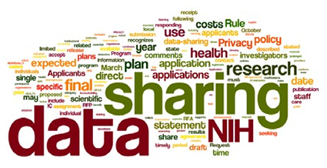
Agenda
Alkek Digital & Online Archive Services
Background & Services
Examples of Technology Possibilities
Partnership Opportunities
Texas Data Repository Initiative
Background
Repository Characteristics
Present Timeline

Slide 3
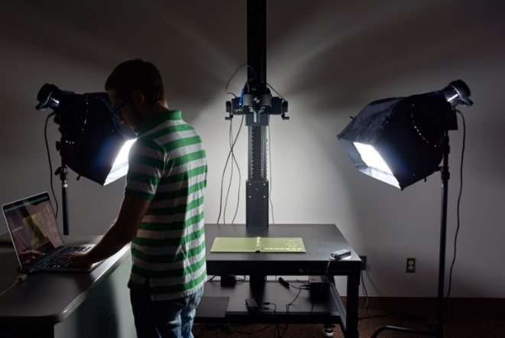
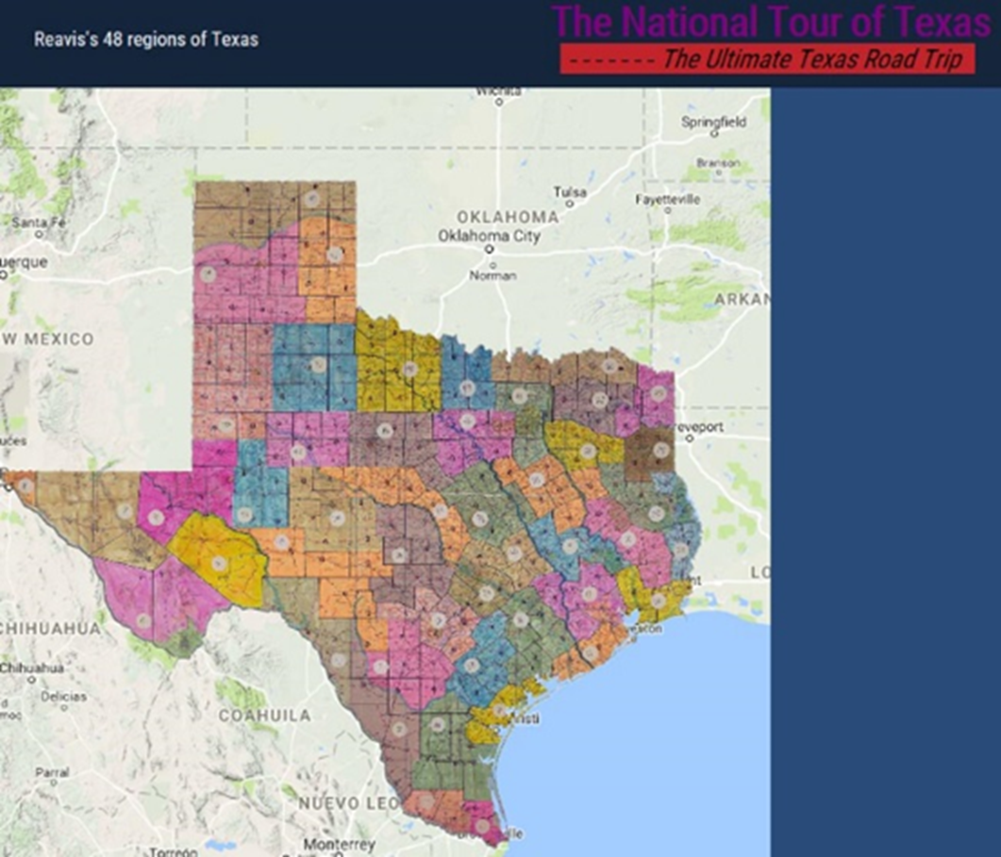
New Digital Initiatives Possibilities For Research Faculty
Alkek’s Dept of Digital and Web Services possesses both programming and imaging possibilities for faculty
Programming possibilities range from publication repositories to digital libraries & online exhibits
Digital imaging possibilities range from OCR for book & journal digitization, 3D objects, posters, audio/video and maps

Slide 4
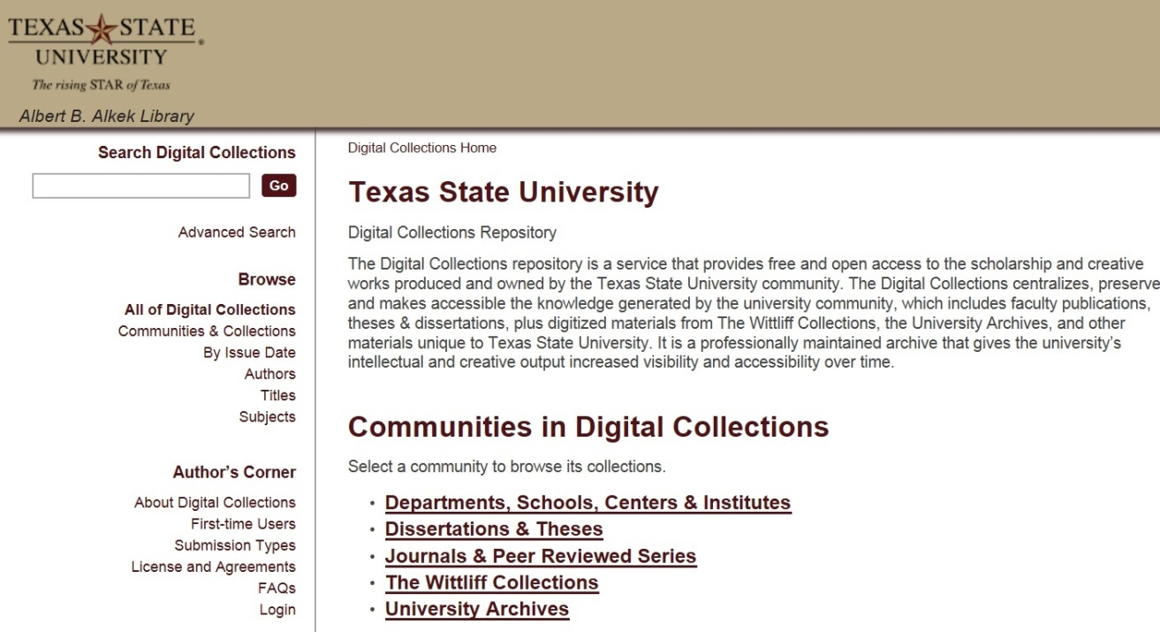
Institutional Repository (MIT, D-Space)
https://digital.library.txstate.edu/
Faculty publications, white papers, preprints, theses, dissertations, working projects
Mary Aycock
Digital Collections Librarian
Stephanie Towery, JD Copyright Officer
Larger Idea, Grant Compliance, Enabling Faculty Research Online, Raising Research Visibility,

Slide 5
Percent Increase in Article Citations by Discipline with Open Access Online Availability (Immediately Available Through Google)
Range = 36%-250%
(Data: Stevan Harnad and Heather Joseph, 2014)

Slide 6
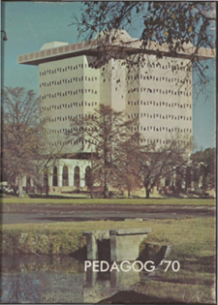
Documentation Projects Significant Manuscripts/Books/Journals/Digital Libraries
Pedagogs Digital Archives
Pedagogs Project 90,000 pages Documentation Project 100 Years of University Yearbooks Page Turning, Zoom Features Searchability across
Decades

Slide 7
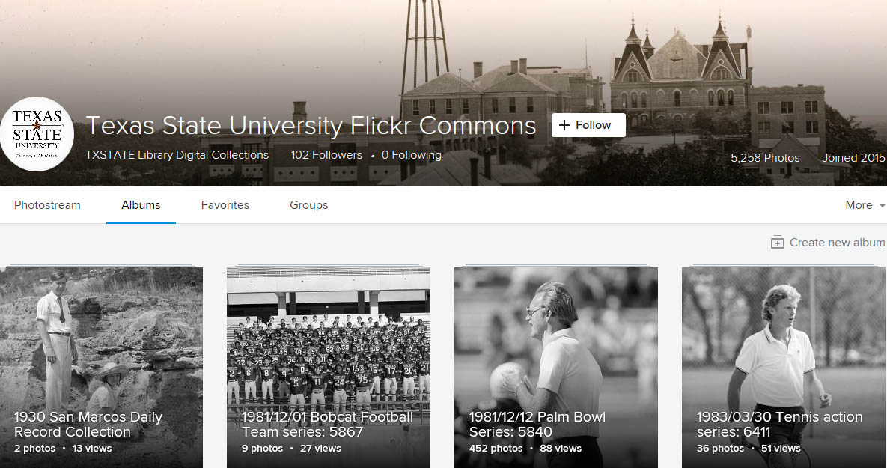
Digital Image Libraries Interactivity/Social Tagging (Metadata)
Texas State University Flickr Commons

Slide 8
Online Exhibits/Digital Archives
Santiago Tafolla Online Exhibit
Front End Online Exhibit/Omeka Presentation Layer Backend D-Space Database (Manuscript)

Slide 9
Multimedia Digital Libraries
The Making of Severo Perez’s And the Earth Did Not Swallow Him
Complex Projects
Multimedia Presentation of Text, Images, Video Oral Histories, Field Notes

Slide 10
Multimedia/GIS/Data Archives
The National Tour of Texas
Dick Reavis 1987 National Tour of Texas
GIS Physical/Cognitive Map Digital Library articles Field Notes, Paratextual Material, Images, Objects, Video

Slide 11
Faculty Online Research Partnership Opportunities
Cognitive Cartography/Multimedia Archives (Video, Text, GIS, Images, Field Notes) Dick Reavis: National Tour of Texas Multimedia, Digital Archives (Digital video, online exhibit images, text, digital archives) Severo Perez: And the Earth Did not Swallow Them Online Exhibits/Digital Archives (images and text, Omeka front end/Database back end) Santiago Tafolla: Mexican Amer. Confederate Soldier Interactive Image Archives (Image libraries, Interactive Commenting/Metadata) Texas State Flickr Commons
Digital Libraries Documentation Projects (Text, Metadata, OCR, Search, Zoom ability, Page Turning) Pedagogs University Yearbooks
Faculty Digitization Proposals/Partnerships
Todd Peters, Head, Alkek Digital and Web Services
Complexity
Projects,Prototypes Grant Partnerships

Slide 12
Part II Data Research Repository

Slide 13
The Texas Data Repository @ Texas State University
Launching January 2017
https://data.tdl.org/

Slide 14
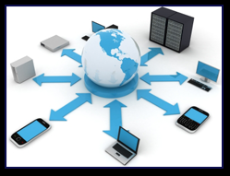
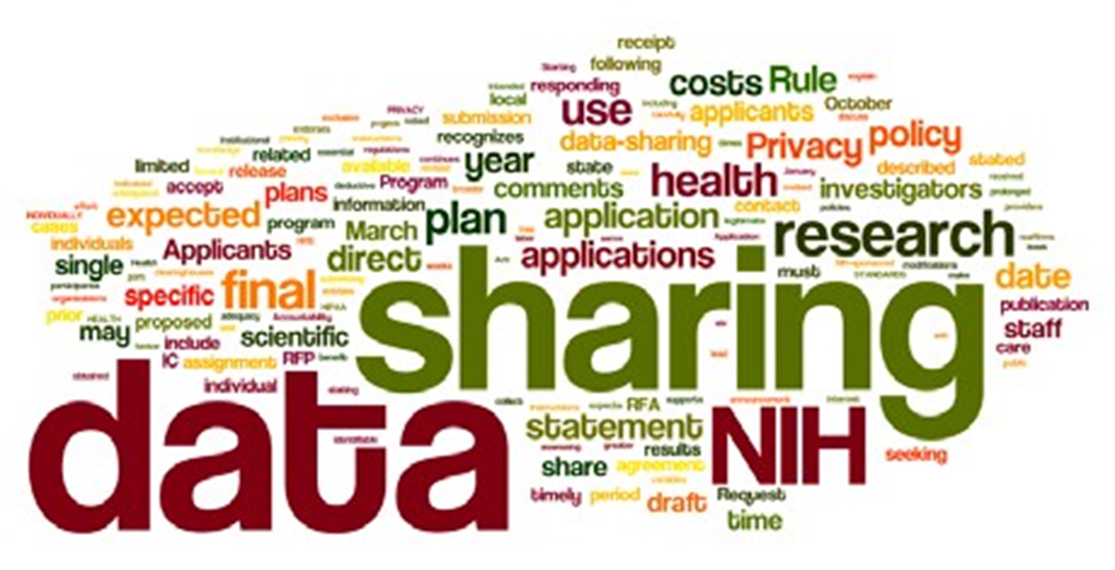
Online Data Repositories
Online Way to Manage a Researcher’s Data/Metadata
Way to Manage Federal Grant Compliance Most major Federal grant agencies require data access as part of the grant proposal/oversite process. (NIH, NSF, NEH, 2013 USDA)
Permalinking Strategy for Online Data Citation & Access, Long Term Data Archiving, Preservation, Sharing Strategy

Slide 15
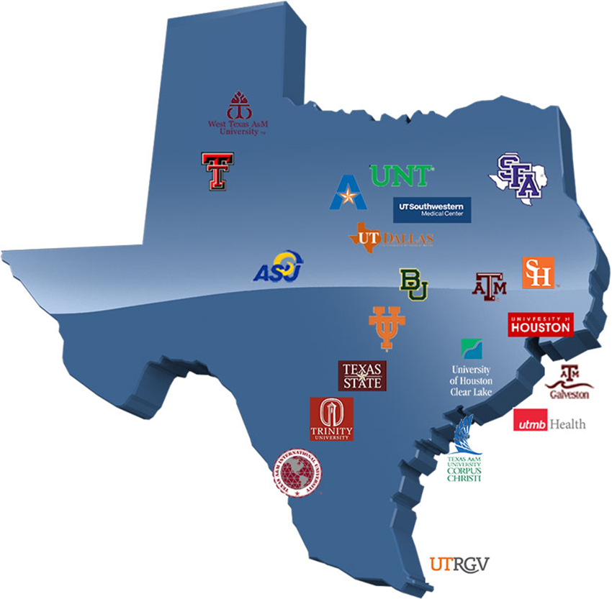
Texas Data Repository Texas Digital Library Initiative, 2014 -2016
TDL Consortium of 22 universities across Texas leveraging technological cooperation among academic libraries,

Slide 16
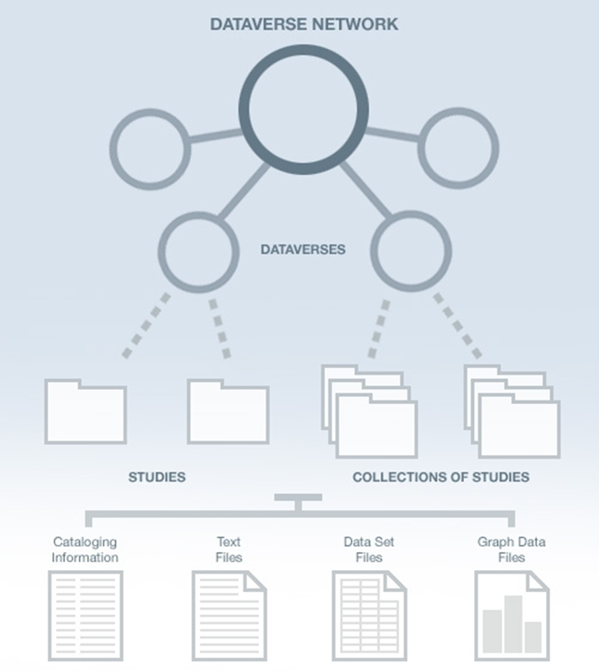
Texas Data Repository Architecture
TDL
Institutions (i.e. Texas State)
Research Study Data Data Set Files
Metadata ( Data Describing the data) Paratextual Research Material (Methodology, Field Notes , Multimedia, Graphs, Programs etc.)

Slide 17
Texas State Research (Data Management Plan)
Research Data
Dataverse
(Regular to Medium Size Data Sets)
Custom Data Storage Solution (Big Data Projects)
Reports and Publications
D-Space Publications Repository

Slide 18
Texas Digital Library (technology)
Texas Data Repository
Steering Committee
(TDL & Data Repository Librarians)
Member Libraries
(service & outreach)
Researchers
(deposit, search, publish)
Notes:
Administering the Texas Data Repository will be done in a hybrid model.
There is a single Dataverse repository hosted by the Texas Digital Library.
TDL provides organizational support in the form of training, tech support, and limited coordination.
Member institutions will provide services based on their local needs and resources. Their roles include:
Each member institution will supply a data repository librarian to manage the data uploaded from their respective institutions, act as a local expert for the repository, and serve on the TDL data librarian repository steering committee.
The steering committee will help TDL recognize trends in research data management, address repository issues, and recommend future groups needed for sustaining data management support.
Any data curation support will also be provided by the member institution
The user is responsible for depositing data
This hybrid model is flexible enough to accommodate different processes at different institutions (some requiring library intervention during ingest, some may not).

Slide 19
Texas Data Repository
Open source platform led by Harvard
Ability to share with trusted research groups prior to publication
Ability to version datasets
Supports data citations (e.g. DOIs, recognition and credit)
Fulfill Federal Data Management Plan requirements

Slide 21
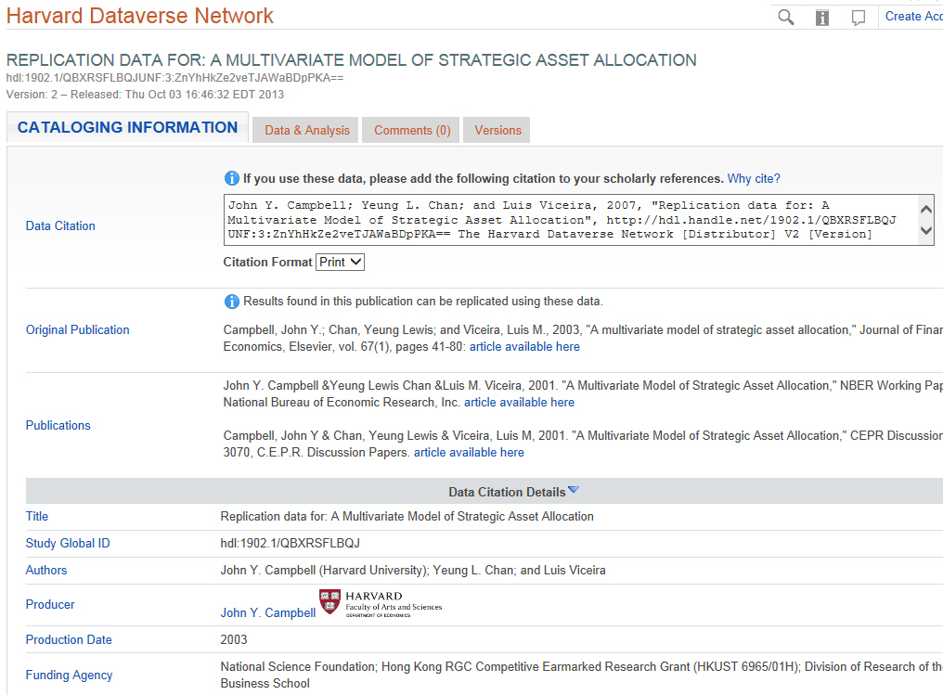
Dataverse Metadata Example

Slide 22
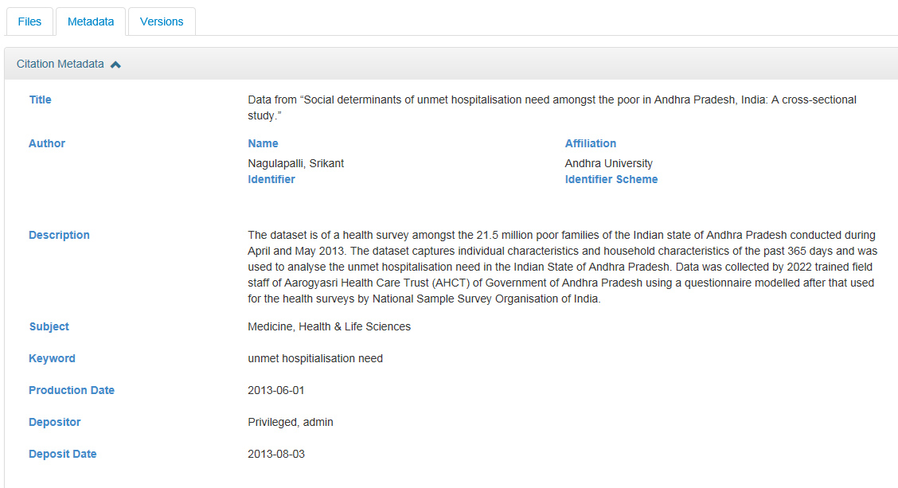
Dataverse Metadata Example (From the Simple to Complex)
Metadata Schemas Supported: GeoSpatial, Life Sciences, Astronomy and Physics, Georeferenced Data

Slide 23
http://data.tdl.org/

Slide 24
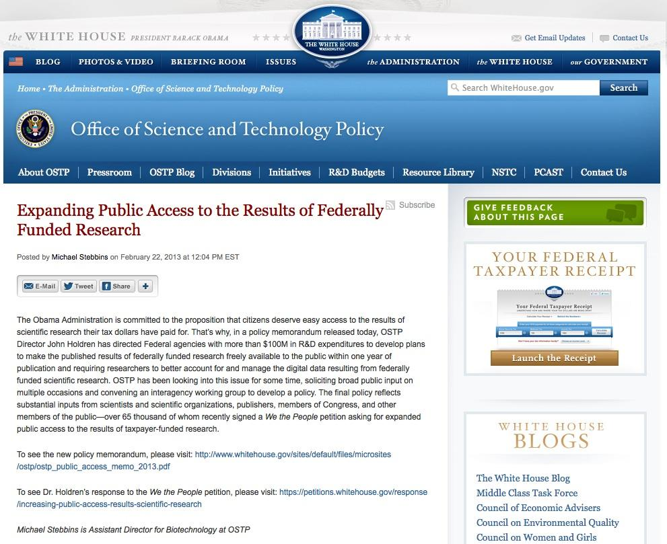
Texas State University Library Infrastructures & Federal Mandates
The Library Supports:
Article Publication repositories D-Space
Data repositories Texas Data Repository
Human Resource Infrastructure
Data Repository Liaison Publication Repository Liaison Subject Liaisons (Outreach) Diana Morganti (TDR, Outreach) Paivi Rentz (TDR, Technical)
http://www.whitehouse.gov/blog/2013/02/22/expanding-public-access-results-federally-funded-research

Slide 25
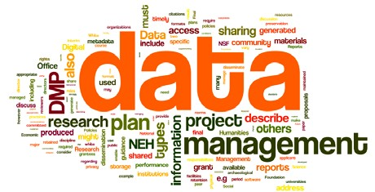
Texas Data Repository Initiative December 2016 - December 2017
Current Dates Online Research Data Symposium (Baylor, November 15-16) Texas State – Shibboleth Authentication/MOU Signoff, November Official Launch of Data Repository (Spring Semester, 2017) Inaugural Year/Local Infrastructure (January – December, 2017)

Slide 26
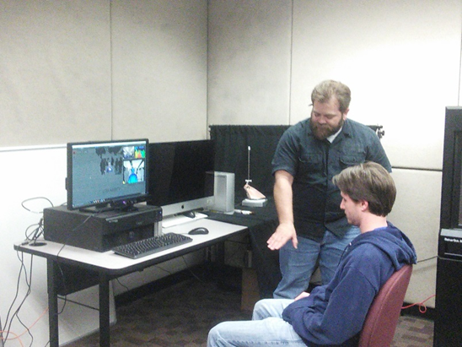
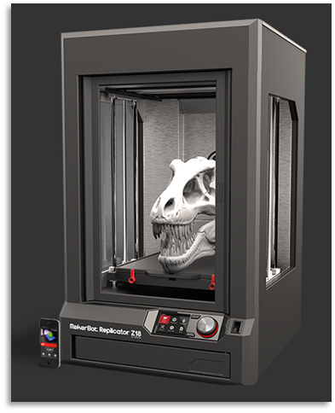
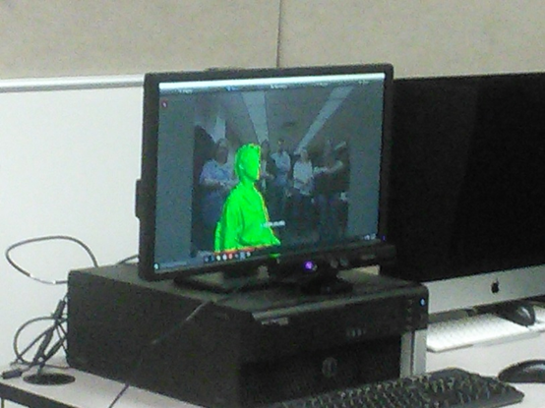
3D Printer Lab & Services Fourth Floor
Interdisciplinary Collaborative Environment
3D Printers
3D Scanners
Spectrum of Software Hardware Infrastructure (PC’s, peripherals, filament Etc.)

Slide 27
Further Links
Alkek Library Digitization Services
Library Digital and Web Service Services Department
Faculty Digitization Services (Proposals)
Digitization Services For New Faculty (Proposal outlines)
3D Printing at Alkek Library
Texas Data Repository
Texas Data Repository
Texas Data Repository Final Report (October, 2016), Selection Process, Aug. 2015
Uzwyshyn, R. 2016. Research Data Repositories: The What, When, Why and How of Data Research Repositories Computers in Libraries.
Texas Digital Library. Texas Data Repository Presentation. Video. (October, 2016)
Federal Research Sharing Policies. SPARC. 2016

Slide 28
Comments and Questions

