Slide 1
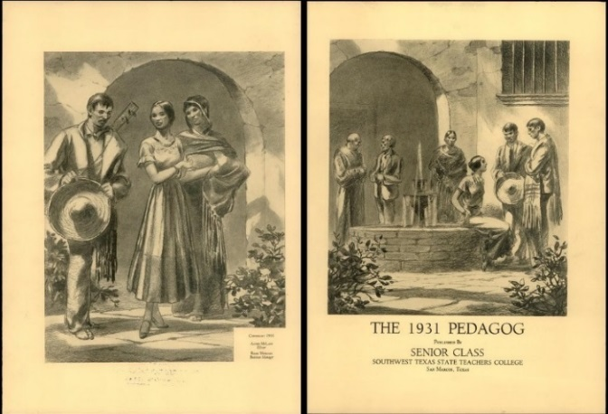
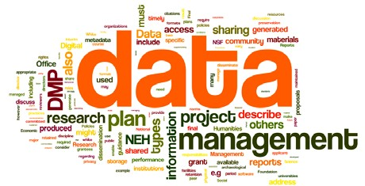
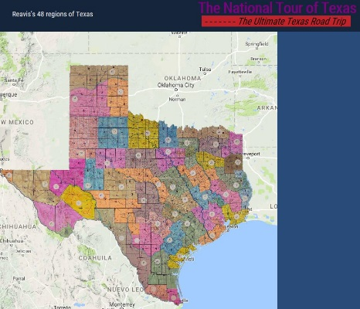
Digital Related Services for Faculty (Division of Collections and Digital Services)
Ray Uzwyshyn Director, Collections and Digital Services
Texas State University Library R_U15@txstate.edu, (512) 245-5687

Slide 2
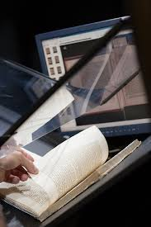
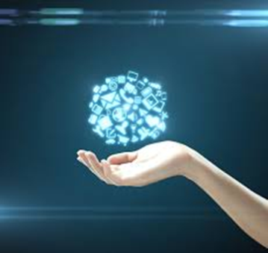
Digitization Services for Faculty
1) Institutional Repository: Digital Access Services
2) Digitization, Scanning & Metadata Services
3) Partnering Possibilities for Faculty Research to Create Digital Libraries & Online Archives

Slide 3
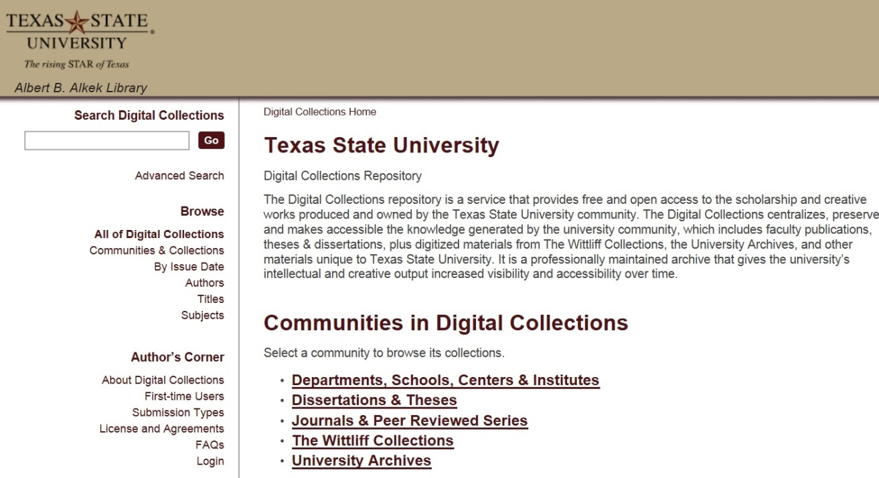
Institutional Repository
https://digital.library.txstate.edu/ (MIT, D-Space)
Enabling Faculty Research Online
Open Access to Research Scholarship
Grant Compliance (Federal Grants)
Raising Research Visibility Self Service Application
Jeanne Hazzard Digital Collections Librarian
Stephanie Towery, JD Copyright Officer
Faculty publications, white papers, preprints, theses, dissertations, working projects

Slide 4
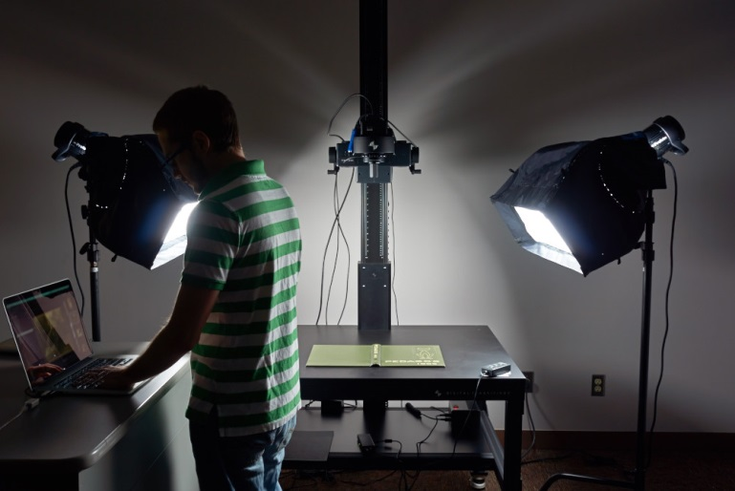
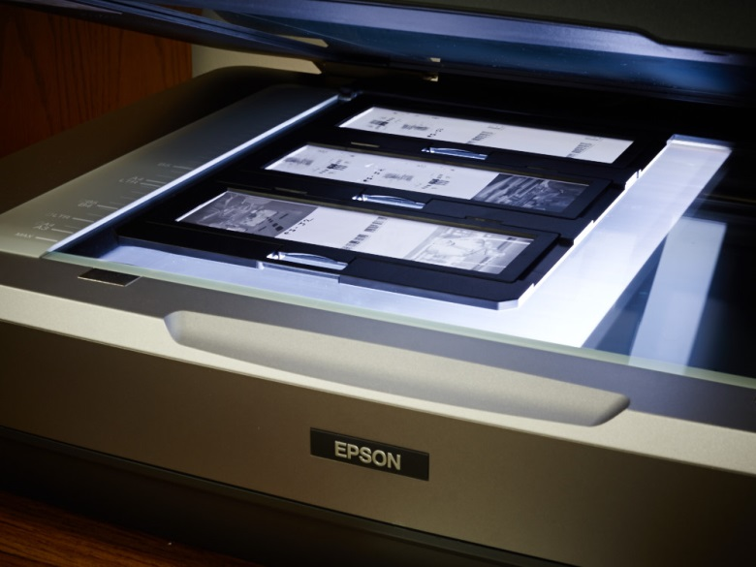
Alkek Digitization & Web Services Unit
Spectrum of Hardware & Software Services
Museum Level Setup: Imaging, Digitization & OCR
Books, Journals, rare materials, 3D Objects, Posters, Maps, Audio and Video
Spectrum of Software/ Programming Possibilities
Digital Libraries/Online Archives, Digital Exhibits, More Technologically Complex Projects Faculty Digitization Proposals/Partnerships

Slide 5
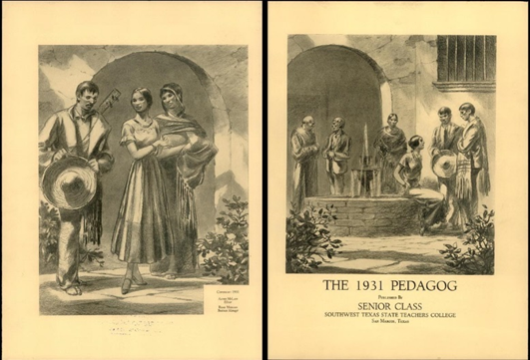
Research Projects Prototypes, Grant Partnerships
Digitization Projects FY15 – FY16
Pedagogs University Yearbooks 1900-2000’s, Cormac McCarthy’s Blood Meridian, Wittliff
Santiago Tafolla: Mexican Amer. Confederate Soldier
Severo Perez: And the Earth Did not Swallow Them (Digital Video, Images online Exhibit, Digital Archive, multimedia)
Dick Reavis: National Tour of Texas (Interactive GIS, Images, Documents, Digital Video, Online Exhibit and Digital Archives)

Slide 6
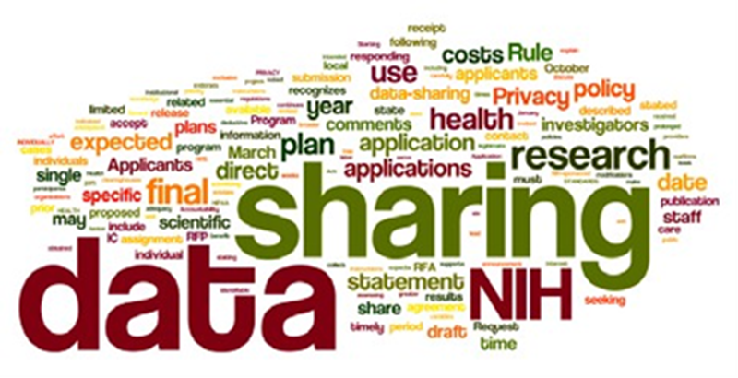
Texas Data Repository Launching Dec. 2016 http://data.tdl.org/
Texas Data Repository
Consortial initiative/ software framework that will enable Texas State with regards to sharing, data citation, publishing and management of research data
Grant Compliance

Slide 7
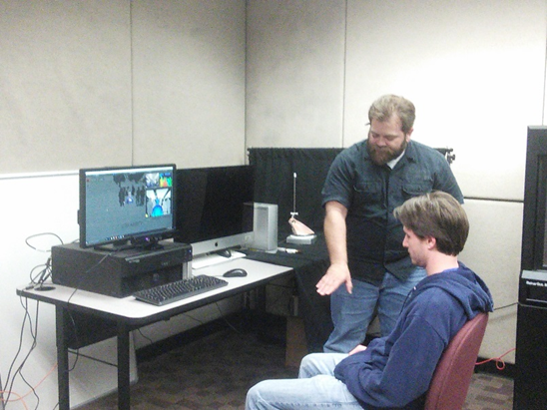
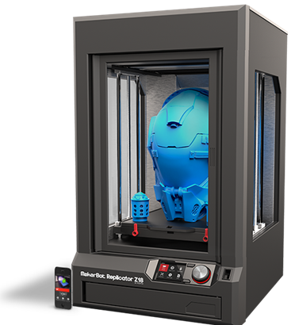
New 3D Printer Lab & Services (Fourth Floor)
Built as Interdisciplinary Collaborative Environment
3D Printers
3D Scanners
Spectrum of Software Hardware Infrastructure (PC’s, peripherals, filament Etc.)

Slide 8
Hybrid Research Tools (Pilot Year 2) SAAS + Content Database
Reading List Builder
Browzine
Online Academic Journals
Online Library Content + LMS (TRACS)

Slide 9
Comments/Questions

Slide 10
Contacts
Ray Uzwyshyn, Dir. Coll. and Digital Services, r_u15@txstate.edu
Todd Peters, Head Digital and Web Services, tp09@txstate.edu
Ginger Williams, (Head, Acquisitions) ginger.Williams@txstate.edu
Jeremy Moore, Digital Media Specialist, jeremy.moore@txstate.edu
Jason Long, Library Programmer, j_l408@txstate.edu
Jeanne Hazzard, Digital Collections Librarian, jh201@txstate.edu
Stephanie Towery, Copyright Officer, sst25@txstate.edu

Slide 11
Percent Increase in Article Citations by Discipline with Open Access Online Availability
Range = 36%-250%
(Data: Stevan Harnad and Heather Joseph, 2014)

Slide 12
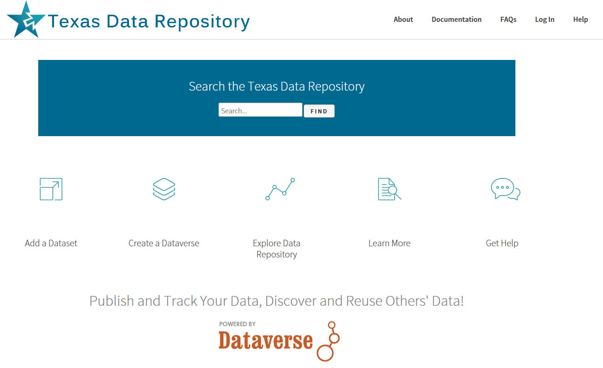
Landing Page:
http://data.tdl.org/

Slide 13
Consortial Repositories, http://www.tdl.org/data-repository

