Slide 1
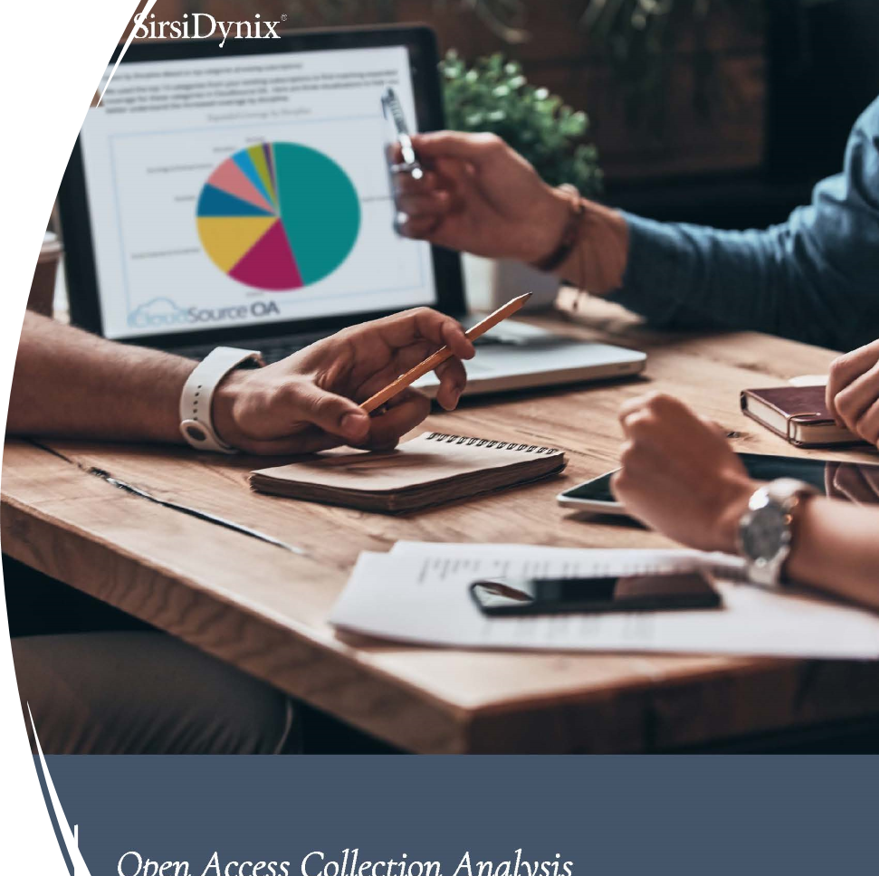
Working Together: Cloudsource+ and Article Galaxy Scholar
New Paradigm Models Analytic Methods & New Budgetary Possibilities
Ray Uzwyshyn, Ph.D. MBA MLIS, rju13@mstate.edu Associate Dean for Collection Management & Strategy Mississippi State University Libraries

Slide 2
MSU Collections Budget Strategy New Technology + Synthetic Analysis
MSU libraries are strategizing utilizing Open Access high quality academic e-resources and technology: CloudSource+ with Article Galaxy Scholar to leverage current holdings towards: Large Budget Savings, New Open Access Possibilities & New Methodologies for analyzing and purchasing Digital e-resources

Slide 3
E-Resources Paradigm Shift in Light of Diminishing Budgets and Rise of Open Access Resources/Open Educational Resources

Slide 4
Cloud Source Plus Aggregates Open Access Scholarly Books and Journals
There are over 60 million open access (OA) refereed scholarly journal articles and academic scholarly books now available on the open web. Freely available open access material accounts for more than half of all released scholarly academic journal articles every year globally. This trend has been accelerating and is expected to continue. Cloud Source+ Aggregates this open access material.
MSU libraries are leveraging these trends with CloudSource+ and Article Galaxy Scholar towards our budget and new open access possibilities

Slide 5
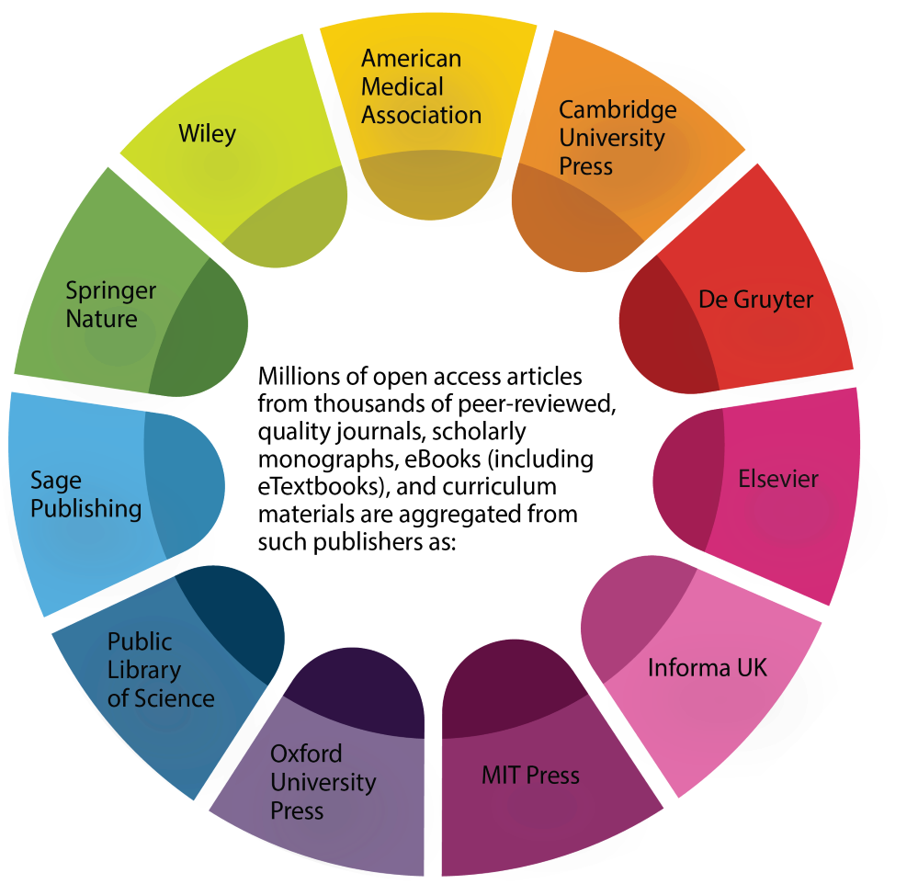
Cost / Benefit Strategy
Aggregates Open Access Content from High Quality Publishers
Allows purchase of focused Journal/Articles not Available in Present Collections/OA

Slide 6
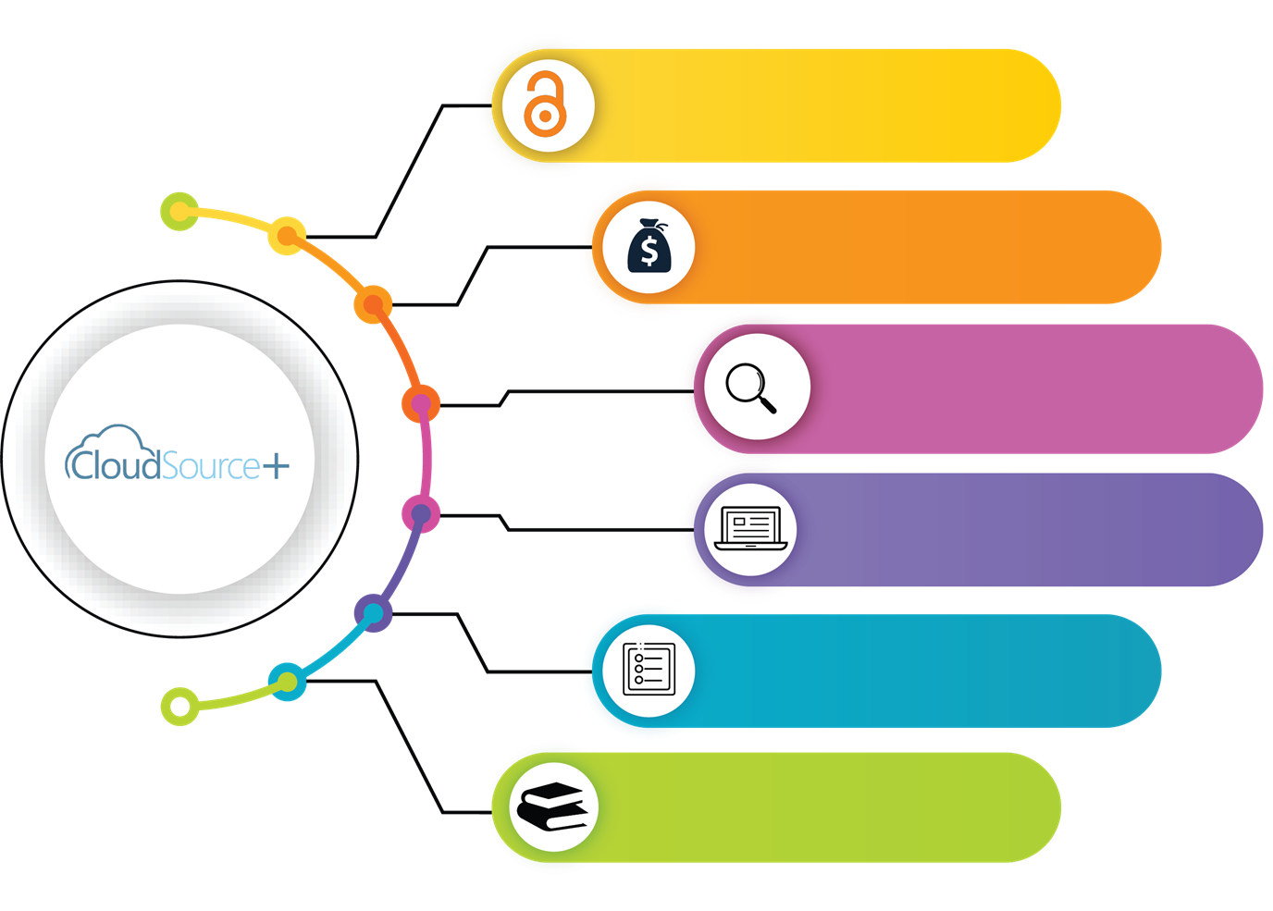
Presents Current Library Journal Subscriptions
Open Access Savings
Budgetary Strategy
60 Million high quality OA scholarly resources
48 Million Open Access Articles (100K Journals)
High Quality Indexes
Support for OER & Open Textbooks

Slide 7
Article Galaxy Scholar
Provides Document Delivery/On-demand Articles
Replaces Dropped and/or Needed Journal subscriptions
Fills a gap for focused resources for research
Allows further access to 30,000 journals from leading European and North American publishers

Slide 8
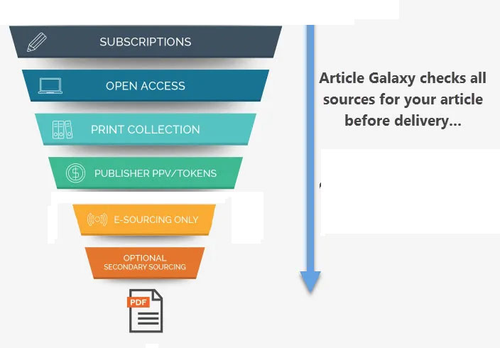
Article Galaxy Scholar Article & Journal Backup Source​ Budget Efficient & Focused

Slide 9
Article Galaxy Scholar Targeted and Focused Purchasing
Allows researchers to request unavailable journals with much more focused & access granted to various university communities. Separate Permissions For:
Individual faculty
Groups of students in a particular course
Entire departments/Schools
Processes are mediated by the library

Slide 10
MSU Open Access Research Collections Budgetary Strategy
Making Better Data-informed E-Resources Budgetary Decision making and Materials Budget Digital Resource Allocation

Slide 11
E-Resources Materials Review Strategy Cost /Benefit Analytic Approach Three-Pronged Synthetic Evaluation Strategy
Qualitative Analysis +
Quantitative Analysis +
Overlap Analysis =
Goals:
Better Budgetary Data-Informed Decision-Making
Improved and Better Resource Allocation

Slide 12
Qualitative Analysis
Email Subject: The library is currently engaged in a comprehensive evaluation of our electronic resource subscriptions. To make data-informed decisions regarding subscription renewals. We are seeking input from our teaching and research faculty on quantitative and qualitative aspects of our e-resource usage. In this regard, we would be grateful if you could provide feedback on your use of the following Database . . . We have enclosed forms that seek your input on these databases. . .
Emails, Survey Form, Focus Groups, & Individual/Group Meetings

Slide 13
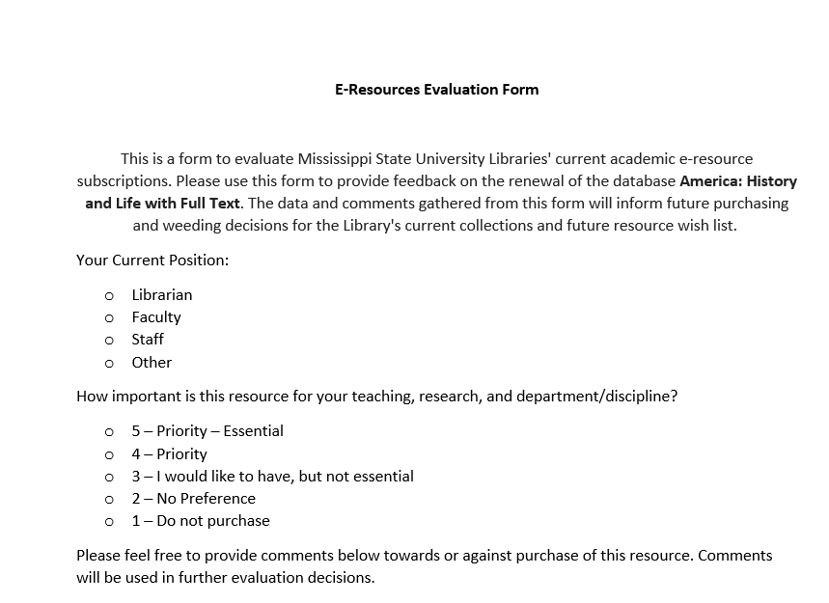
Qualitative Analysis Evaluation Form
Stakeholders:
Department Heads
Faculty
Graduate Students

Slide 14
Qualitative Comments
Stakeholders:
Department Heads
Library Representatives
Faculty
Graduate Students

Slide 15
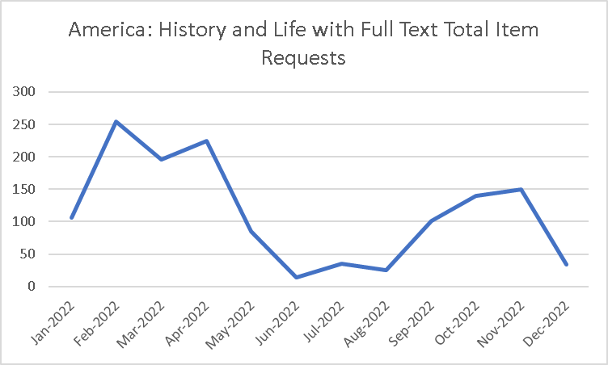
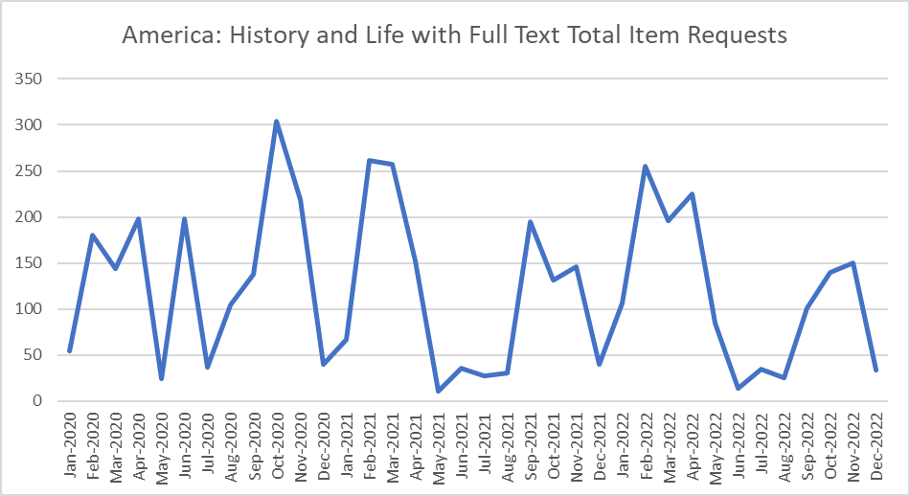
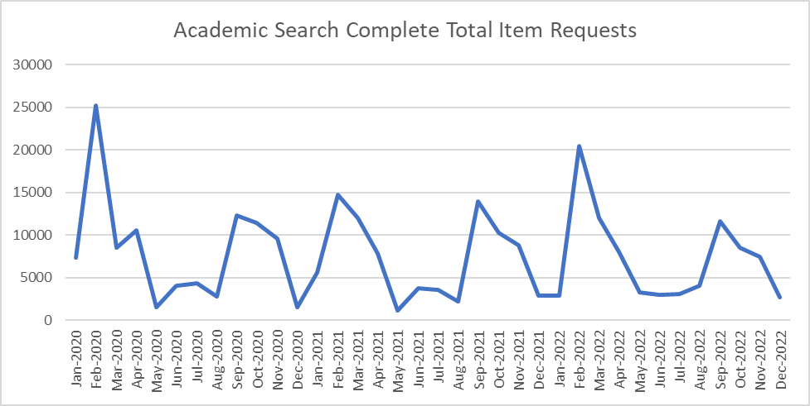
Quantitative Analysis
Quantitative evaluation metrics:
Downloads
Searches
Unique Site visits
Unique site visitors
Cost/Use

Slide 16
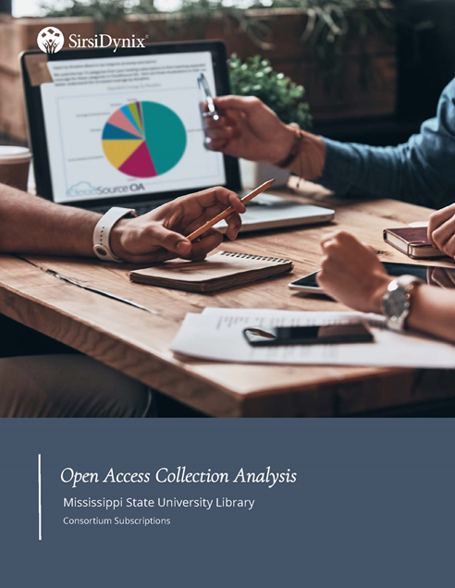
Overlap Analysis Open Access Collection Analysis Report CloudSource+ (SirsiDynix)

Slide 17
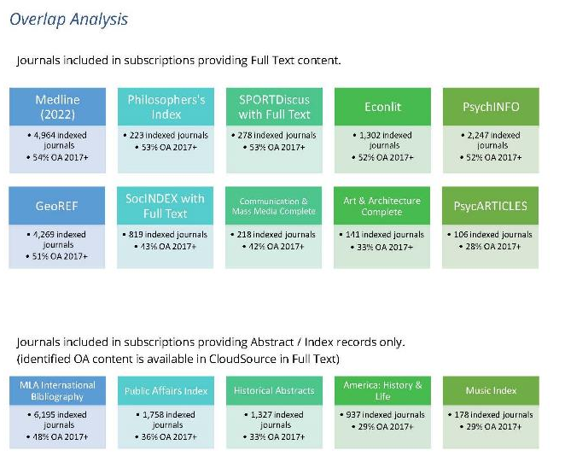
MSU Current Database Holdings vs. Cloudsource+ Open Access Possibilities Select MSU Full Text Databases and Journal Subscriptions Overlap Analysis Shows that our paid subscriptions ranged from 19-79% overlap open access content
Select MSU Abstracts, Indexes and Bibliographies
MSU Libraries Overlap Analysis

Slide 18
Cloudsource+ Overlap Analysis and Metrics
Select MSU Databases Reviewed between February – May 2023
Wide Range of Database Overlap for Full Text journal open access article Coverage
aggregated in
CloudSource+ Mediated coverage available through Article Galaxy Scholar
Database | CloudSource+ Open Access Coverage
Academic Search Complete | 69%
CAB Abstracts 1990-present | 75%
Communication & Mass Media Complete | 42%
EconLit | 52%
EconLit with Full Text | 51%
GeoRef | 51%
Historical Abstracts | 33%
Historical Abstracts with Full Text | 41%
Library and Information Science Source | 72%
Linguistics & Language Behavior Abstracts (ProQuest) | 66%
MedLine | 54%
MLA International Bibliography | 48%
Music Index | 29%
Philosopher’s Index | 53%
Public Affairs Index | 36%
SocIndex with Full Text | 43%
SportDiscus with Full Text | 53%
Wildlife and Ecology Studies Worldwide | 51%
Average % of coverage | 48.04%

Slide 19
Final Synthetic Analysis Conversations and Discussions
Decision Making Data Informed Data Driven
Overlap Analysis
Intersectional Space
Quantitative Analysis
Qualitative Analysis

Slide 20
Analytic Measures | E-Resources Database 1 | E-Resources Database 2 | E-Resources Database 3
Qualitative Analysis | N (Not Needed) | Y (Needed) | S (Split/Mixed)
Quantitative Analysis (Usage) | L (Low Usage | H (High Usage) | S (Split/Mixed)
Open Access Overlap Analysis | H (Overlap >60%) | L (Overlap <40%) | Mixed (40-60%)
Cost | High | Low | Medium
Recommendation Decision | Drop | Keep | Further Discussions Needed

Slide 21
MSU E-Resources Budget Strategy Project Preliminary Findings
Better E-Resources Budget Decisions & E-Resources Digital Resource Allocation Can Be Achieved through:
Synthetic Methodologies Cost/Benefit Analysis Data-Informed Decision-Making Affordances of New Technology

Slide 22
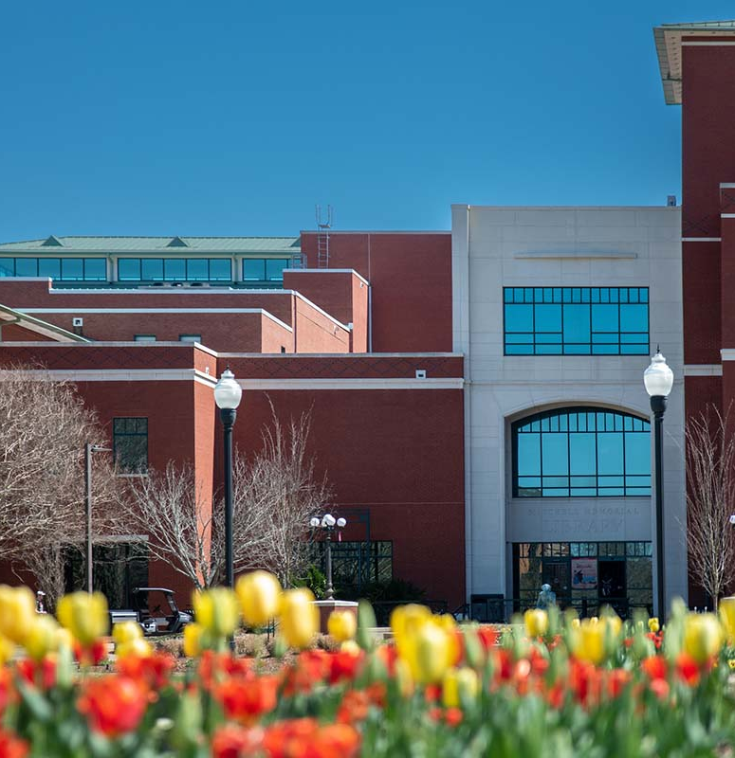
Summary Conclusions E-Resources Budget Evaluation
Significant Cost savings for library budgets can be achieved through new possibilities of leveraging open access and document delivery while maintaining access to scholarly journals and resources
Savings from CloudSource+ Open Access Resources can fund more intentionally aligned possibilities through Article Galaxy Scholar
Project Continuing 2023-2025 Fiscal Years

Slide 23
Thank you!
Questions?
Contact: Ray Uzwyshyn, Ph.D. MBA MLIS Associate Dean, Collections Management and Strategy Mississippi State University Libraries ruzwyshyn@library.msstate.edu, 512-521-6893

Slide 25
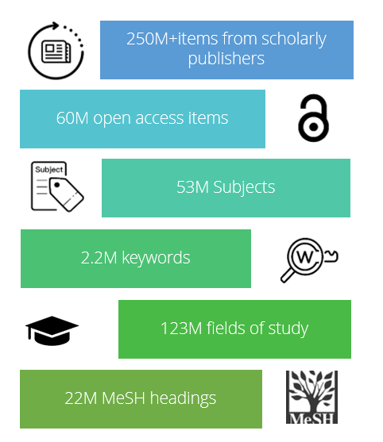
MSU Open Access Research Collections Budgetary Strategy
Quantitative, Qualitative Data collection and overlap analysis as metrics to aid in better data-informed Budgetary decision making

Slide 26
MSU E-Resources Materials Budget Methodologies Strategies
And Goals

Slide 27
MSU E-Resources Budget Strategy Project Summary Conclusions
Making Better E-Resources Budget Decisions & E-Resources Digital Resource Allocation Can Be Achieved through:
Synthetic Methodology Cost/Benefit Analysis Data-Informed Decision-Making Affordances of New Technology

Slide 28
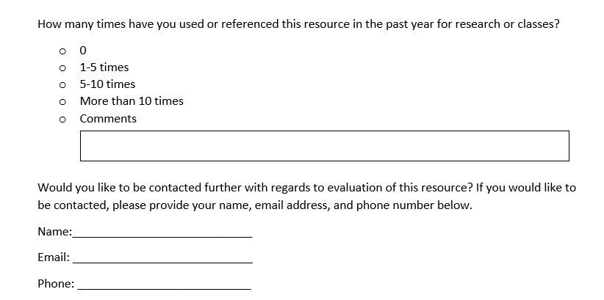
Qualitative Analysis: Evaluation Form
Stakeholders:
Department Heads
Faculty
Graduate Students

Slide 29
