Slide 1
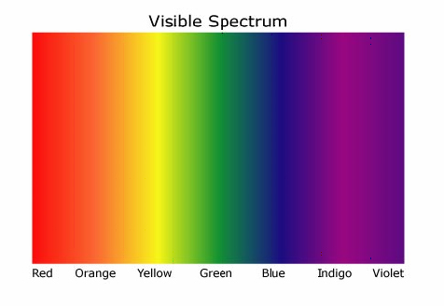
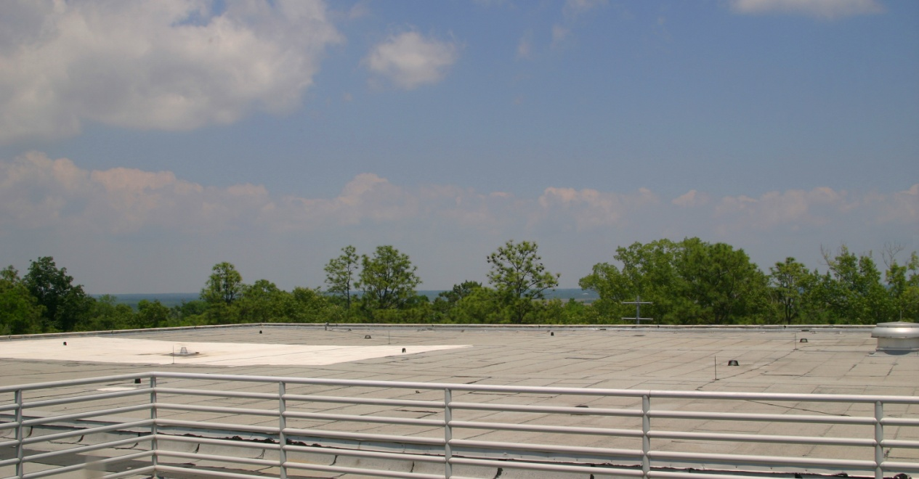
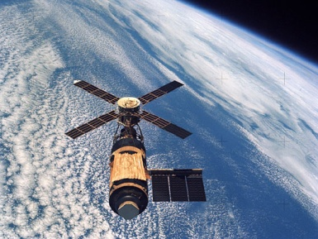
Entering the 21st Century: Grants, Gradients, Libraries & Opportunities
Ray Uzwyshyn, Ph.D. MLIS, Director of Online Libraries American Public University System

Slide 2
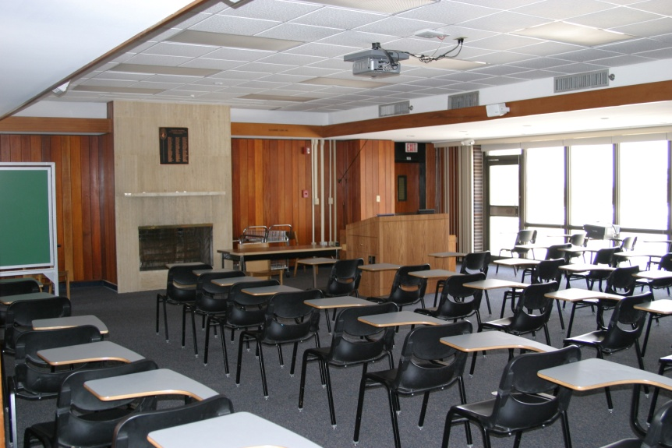
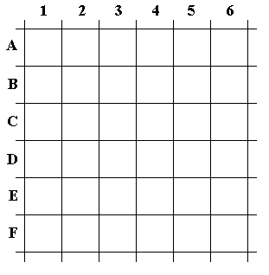
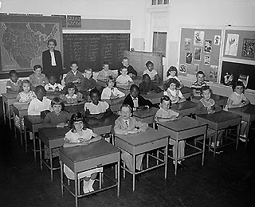
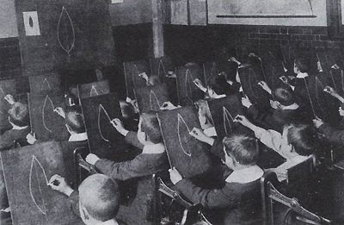
GRANT OPPORTUNITIES BEGIN WITH ENVIRONMENTAL SCAN
Correspondence To Library’s Mission

Slide 3
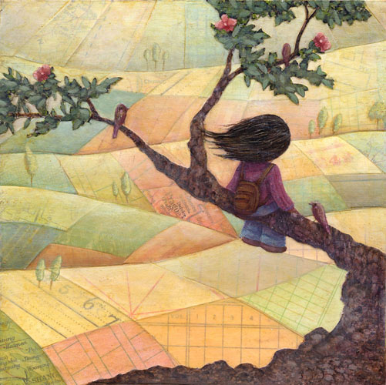
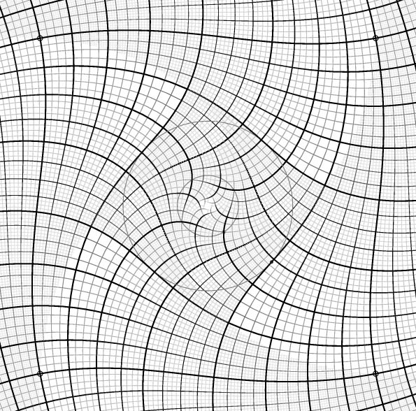
Potential Opportunity: SKYLAB REIMAGINING THE Learning Grid For 21st Century
Synergies for Collaboration (Center for Teaching and Learning, Academic Computing, IT New Learning Vistas, 21st Century Network

Slide 4
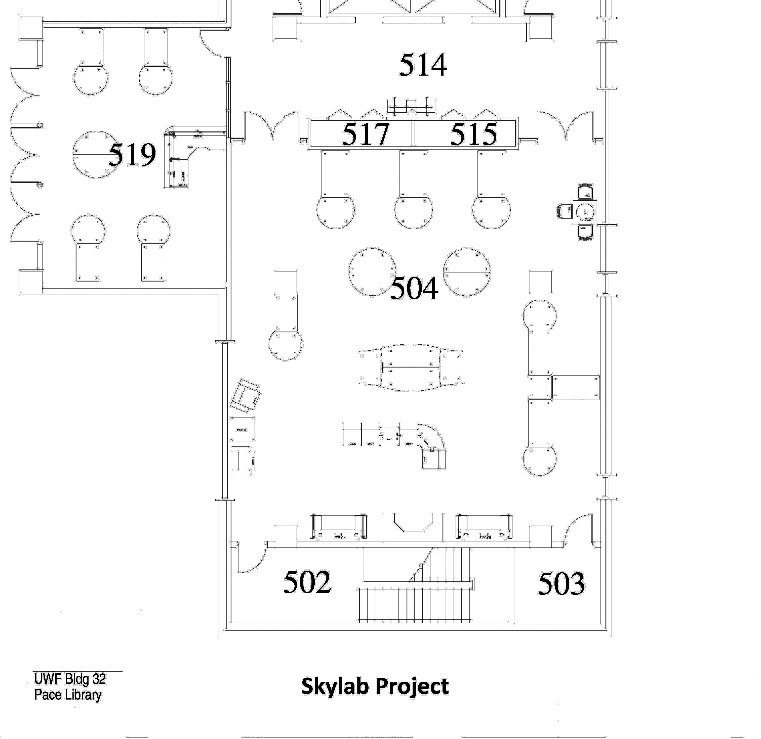
Attractiveness to Outside Funders: Space, Technology, Learning
Information Literacy Classroom Activities
Multimedia Studio Activities
Collaboration Third Space for Learning. Cross-fertilization of
Projects, People and
Skillsets.
Technology
Media Conversion Center Activities
Permeable Boundaries

Slide 5
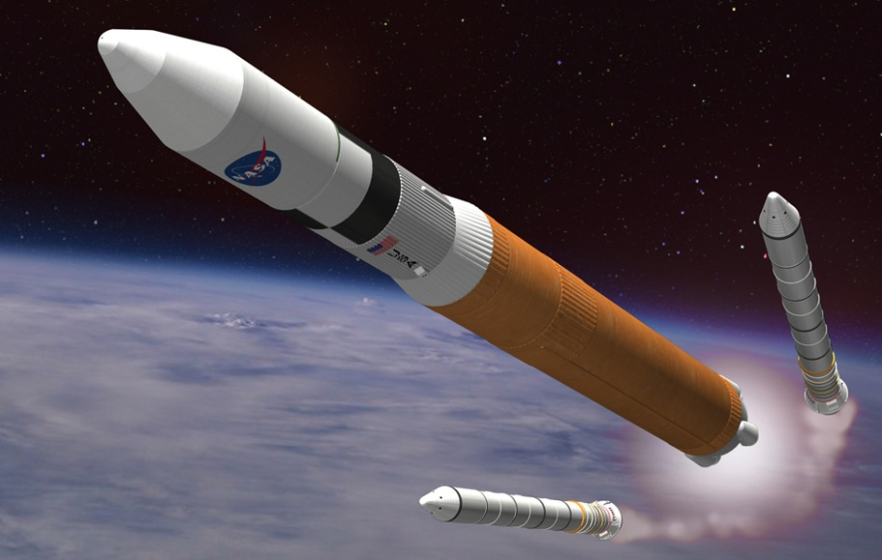
Buy In Process: Begins with Proposal
Information Literacy Classroom
Multimedia Studio
Media Conversion Center
Unifying Theme: Digital Literacy

Slide 6
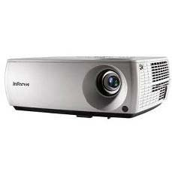
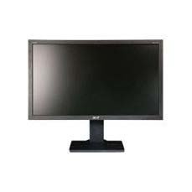
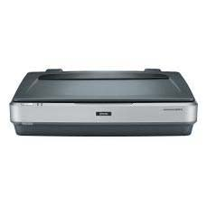
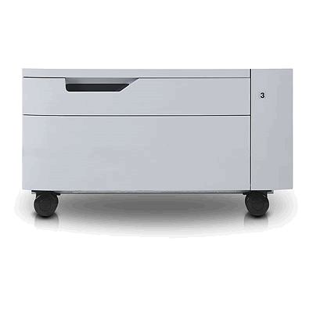
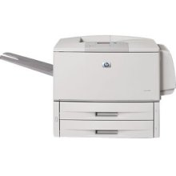
ASSESSMENT of PROJECT Feasibility: Information Literacy CLASSROOM (Buy In)
Main Equipment Components
30x - Dell OptiPlex PCs | $42,240
1x - Infocus digital projector | $1,439.99
3x – Large Format 27# LCD Screens | $1,264.00
1x - Epson Large Format flatbed photo scanner | $2,879
PQA Industrial Printer | 4,380.89
Total | $75,198.46 – 150,00.00
Longer Lists and Specs Available

Slide 7
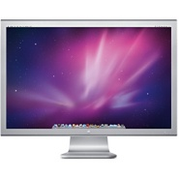
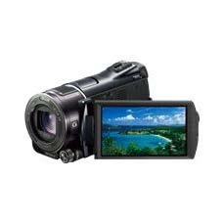
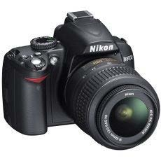
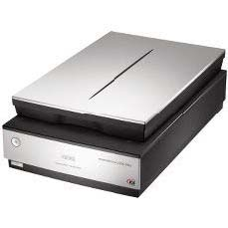
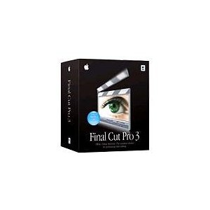
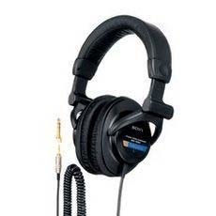
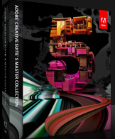
ASSESSMENT of FEASABILITY Multimedia STUDIO
Main Equipment Components (Hardware & Software) 2 Multimedia Macs with Dual Monitors Digital Camcorders Digital Cameras Flatbed Slide Scanners Adobe Creative Suite 5 (Suite of Software) Apple Final Cut Pro (Digital Video)
Total $52,180.00-100,00.00

Slide 8
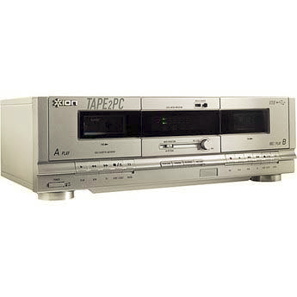
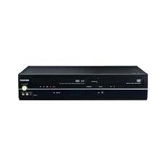
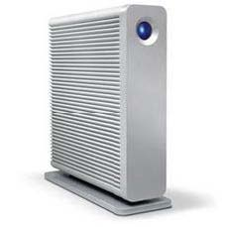
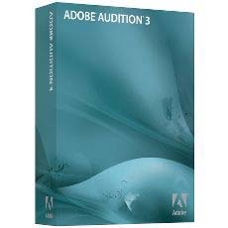
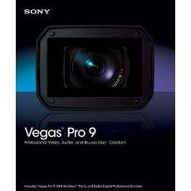
ASSESSMENT of FEASABILITY Media Conversion Center
Hardware & Software Main Components
Cassette to MP3 Conversion Hardware VHS to DVD Conversion Hardware Multimedia port enhanced PC TB Hard drives for Storage Large Format (11x17) Scanner with Slide/Negative Capabilities Headphones & Audio Conversion Software (Audition) Video Conversion/Editing Software (Vegas)
55, 600.00 – 155,000.00

Slide 9
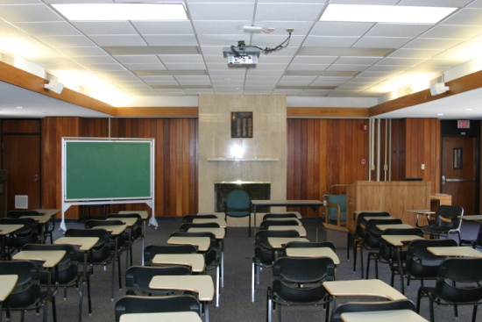
ASSESSMENT of Feasibility
Fifth Floor Existing Blueprints Rough Sketch Overlay
Circulation of Documents (University Telecom,
Furniture Procurement,
Contractors, University Architecture & Engineering)
125,000 (low estimate)
255-550,00.00 (high)

Slide 10
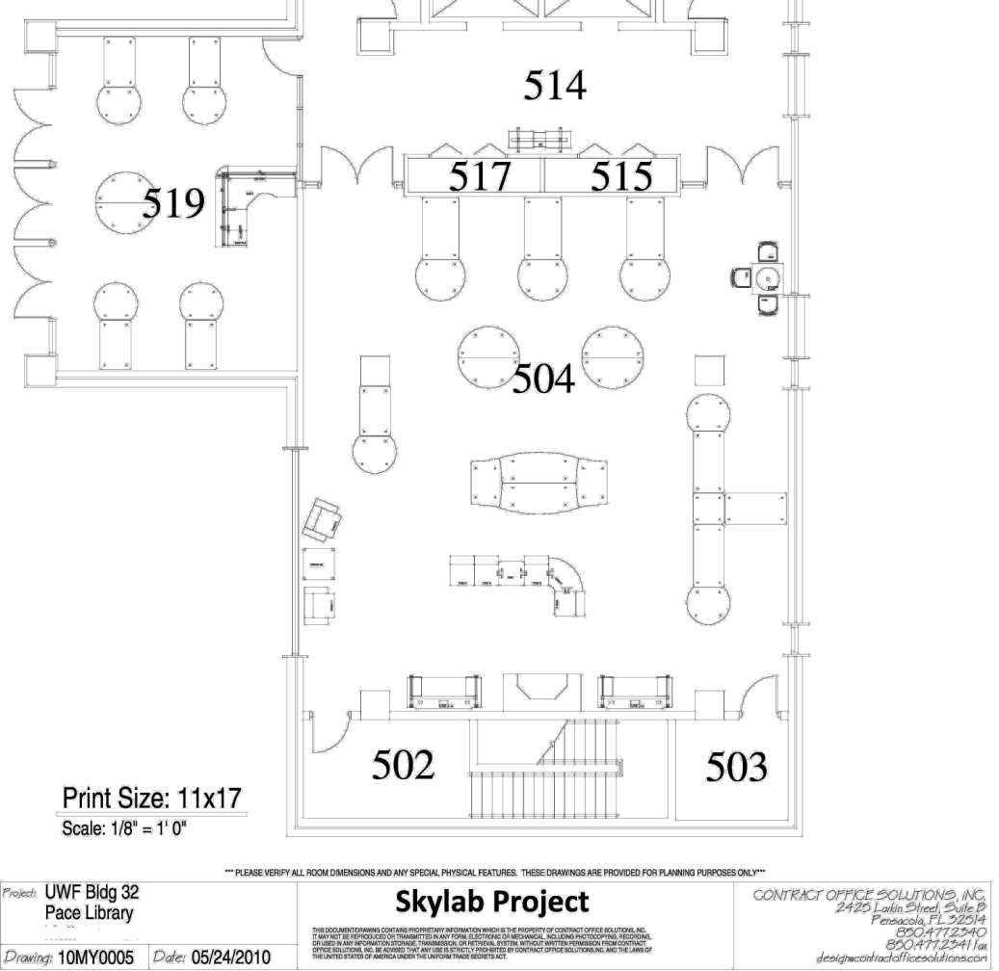
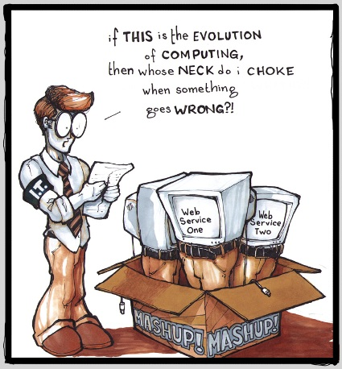
SUSTAINABILITY: Human Resources
Skylab Technology Manager (85,000.00) Student Assistants for Extended (3) Lab Hours Allocate Budgetary Contingency Money for First Year
($)75000.00
150,000.00 (low) – 250,000.00 (recurring)

Slide 11
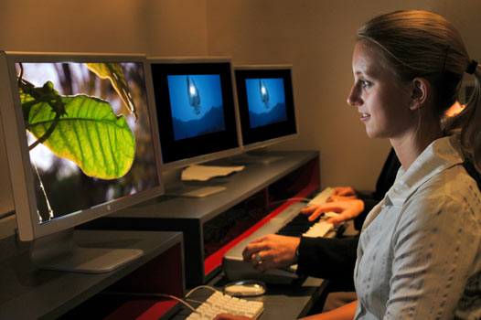
SKYLAB Enabled Project Awarded 500K 250K Grant/ 250 Matching Funds PROVOST
Image Editing Scanning Assistance CD/DVD Creation Digital Audio/Video Capacity Podcasting Website Creation and Design Multimedia Website Specialized Student Digital Literacy Projects
Keyword for 21st Century Libraries: Digital Literacy

Slide 12
RUNNING THE PROJECT: 9 MONTHS Circulation of Documents
Handouts: Tech. Equipment , Schematics Skylab Conceptualization/Grant
Binders Complete Hardware, Software Tech. Specifications Budget Binders Budgetary Documents Skylab Date Log with Primary Documents
Presentations Library Stakeholders Outside Constituents National Awareness/Marketing

Slide 13
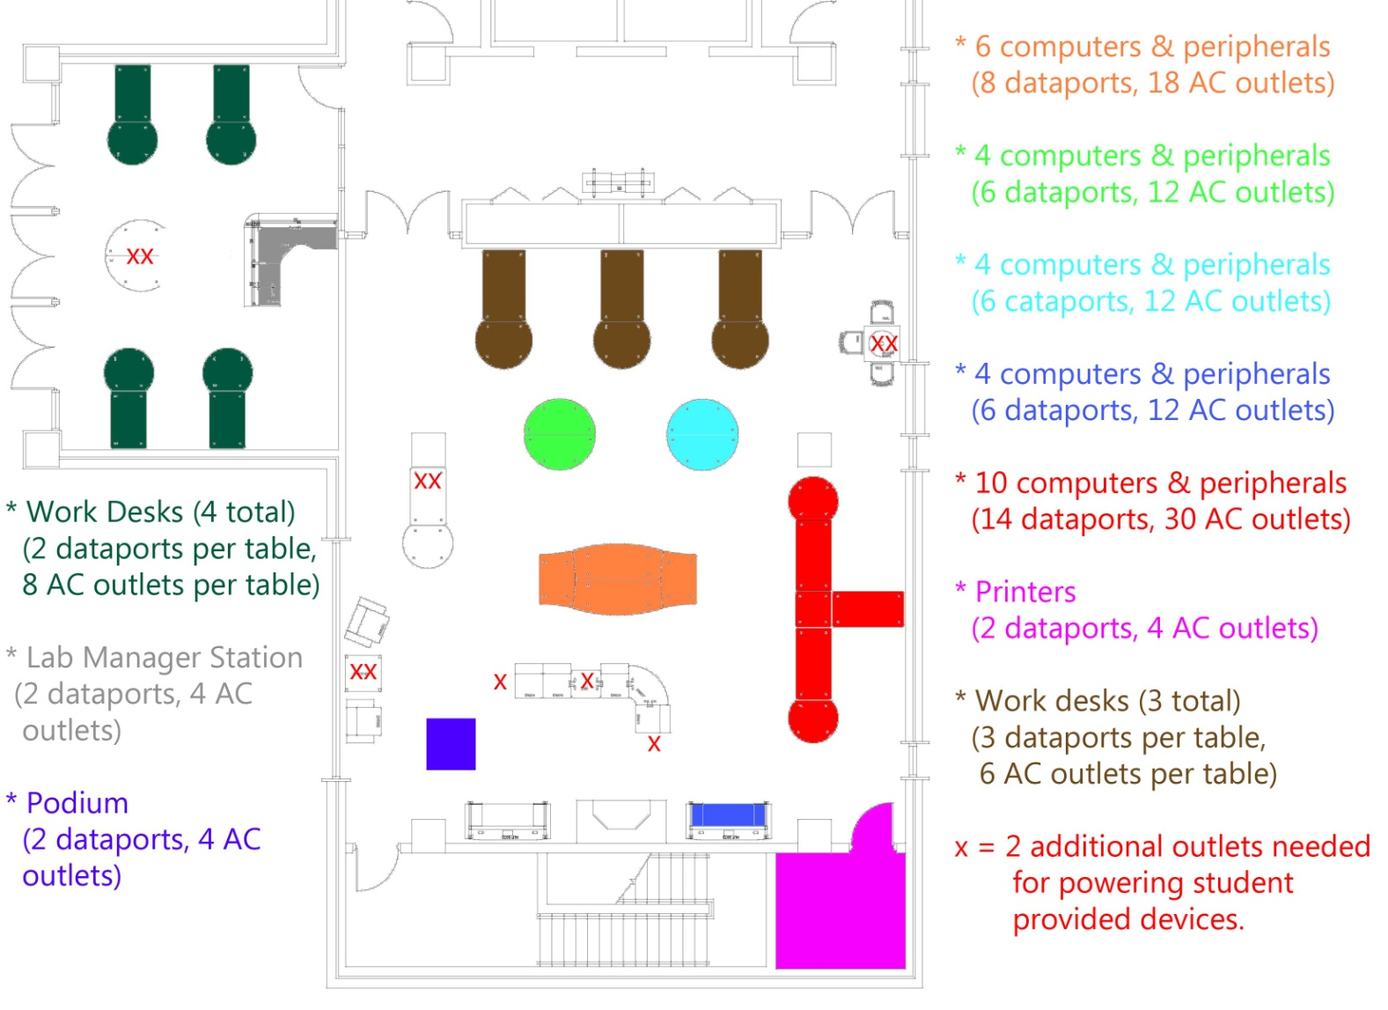
Example: Electrical Data: Design DOCUMENTATION KEY
Data ports and Electrical Outlets: Diagrams for Telecom, Contractors ,Cable Management & Adequate Power Supplies

Slide 14
Example: Architectural Rendering
Various Technologically Enhanced Spaces For
Learning &
Collaboration Guided
By Technology Possibilities:
Binders: Comfortable
Seating,
Mobile Desks, Enhanced Electrical/Data Ports
Non Traditional Classroom
Capabilities
Information Literacy Classroom

Slide 15
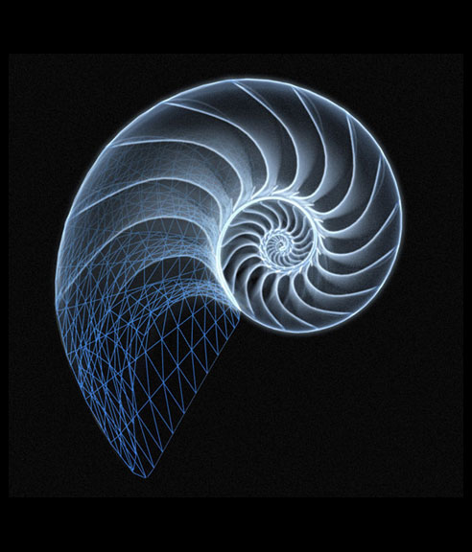
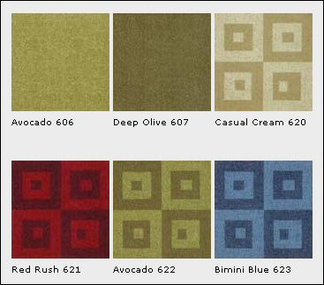
Pre-PLAN AND PLAN AHEAD There Will Always Be UNEXPECTED Contingencies

Slide 16
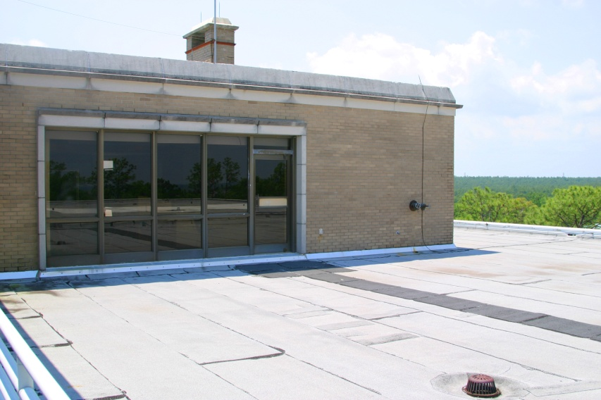
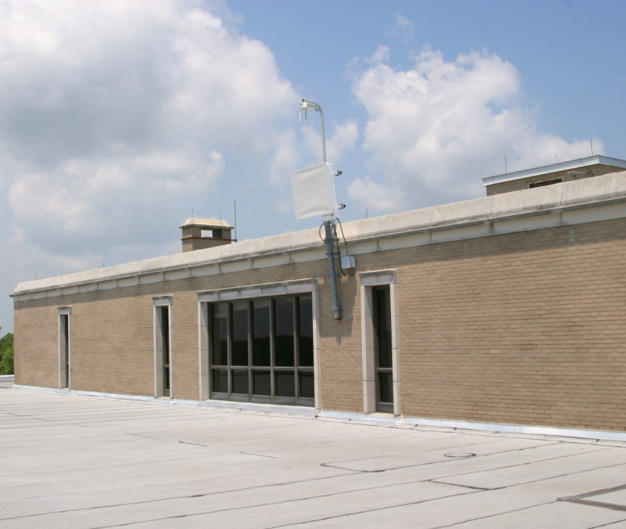
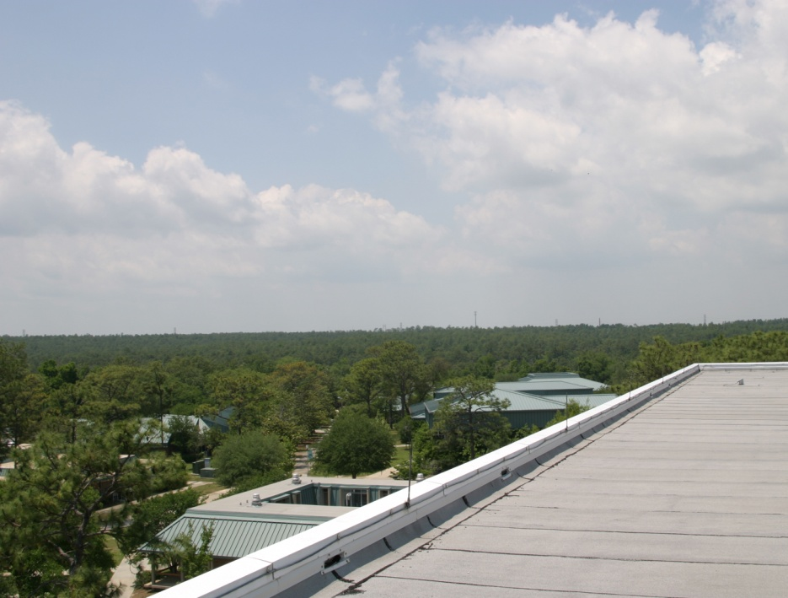
PLAN FOR FUTURE FUNDING SKYLAB PART II: RECLAIMING THE OUTDOOR SPACE
Wireless Access Points, Indoor/Outdoor Future Mobile Computing Possibilities

Slide 17
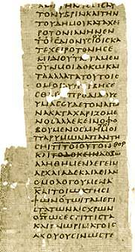
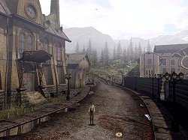
Environmental Scan: Case Two U Miami Digital Initiatives
New Types of Digital Libraries (Large IMLS Grant: Cuban Heritage Digital Collections)
200 B.C
1940
2003
2018
Working within Opportunities of Environment

Slide 18
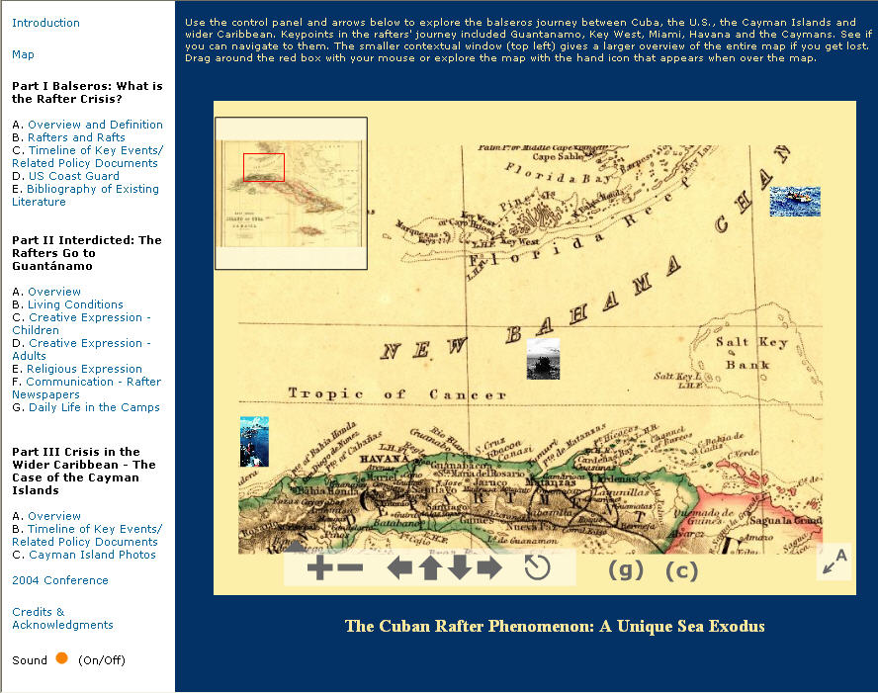
Grant Attractiveness & Technology How Do you Best Navigate Information?
Unique Challenge posed by each specific digital collection
Multimedia and Visual Metaphor

Slide 19
Involve Innovation & Contextualization
What is the Technology Opportunity?
Wider Library Academic University Community Connections

Slide 20
Branding and Marketing the University Globally The Libraries Intellectual Riches Globally
Hybrid Digital/Paper Collections

Slide 21
Digital Infrastructure Use Various Media Types (Audio/Video)
New UM Music Library Possibilities

Slide 22
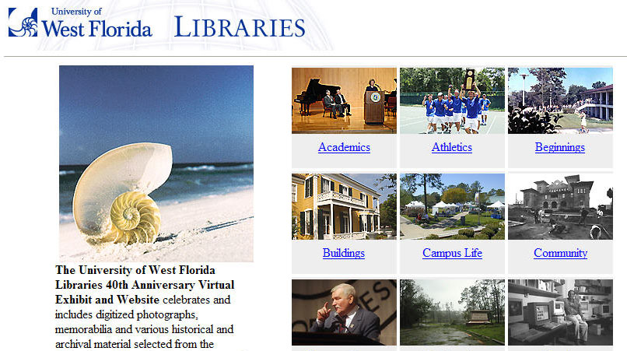
Create University/Library/Environmental Bridges
Community Connected Archive (2006)

Slide 23
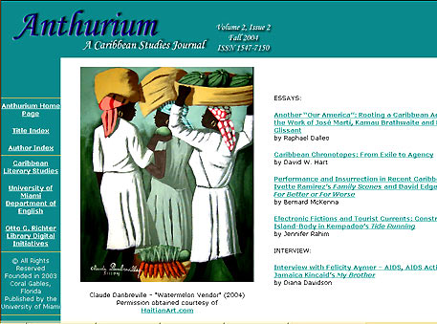
Grants for New Genres of Digital Collections & Library Services: Partnerships
Anthurium (2004) Scholarly E-Journal of Caribbean Studies
English Faculty, Library Special Collections, Digital Services, Art History, Public History
http://scholar.library.miami.edu/anthurium/index.html
Scholarly Communications Opportunities

Slide 24
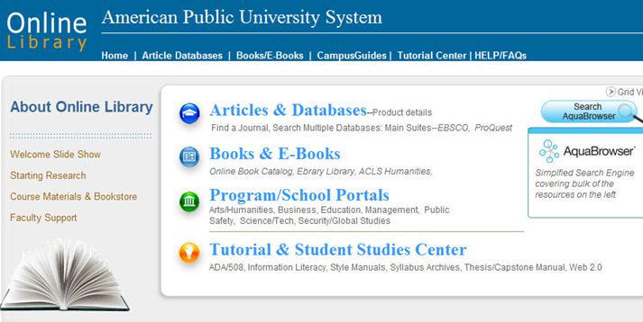
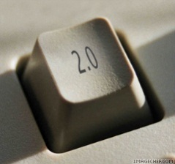
ENVIRONMENTAL SCAN Case Three Mission Alignment
(THE ROI FACTOR & Creating Library Value)
Technology and the Online Academic Library/University

Slide 25
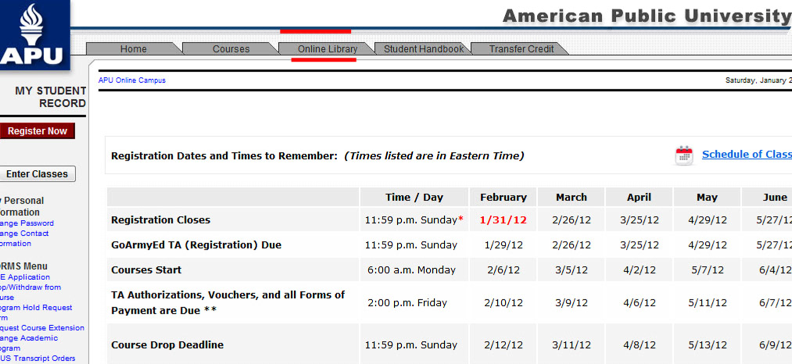
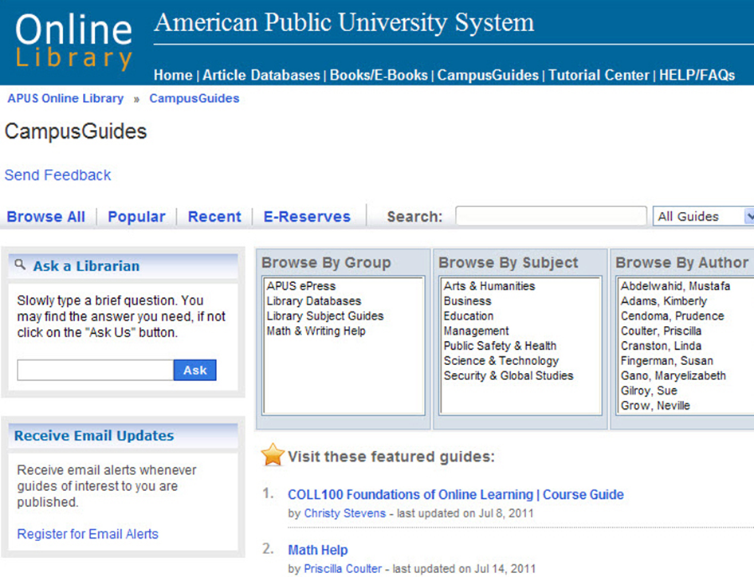
APUS Libraries (For Profit, Completely Online University)
Project Affordances (ROI) Synthesizing Library Holdings, Electronic Course Materials and E-Press
With the Online Classroom (LMS, SAKAI)

Slide 26
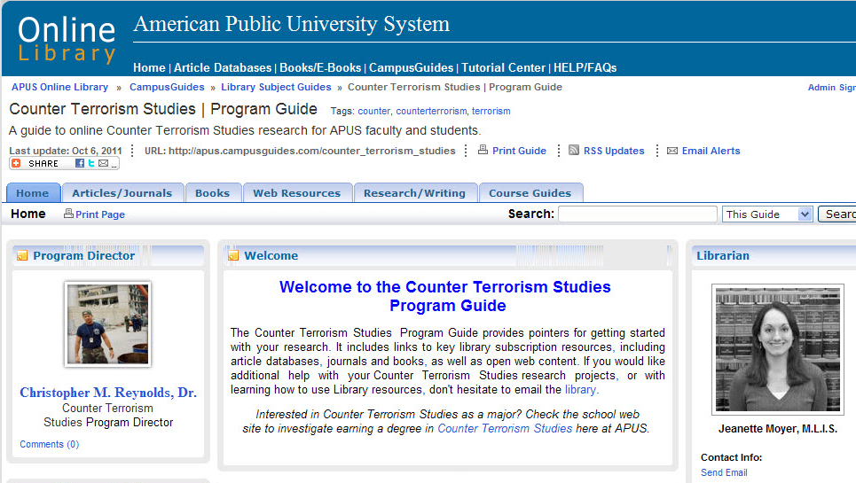
System Wide Application of Media/Curriculum Possibilities Spin off Grant Opportunities (OCIST)
Online Course Guides as Direct Curriculum Replacement School, Program, Department or Course

Slide 27
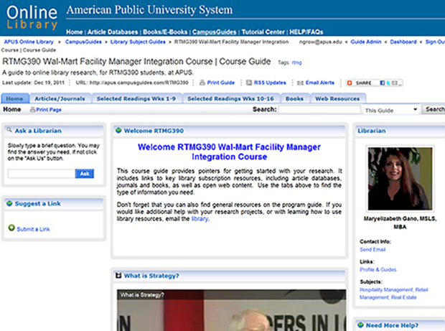
Online Campus Library/University Opportunities (ROI)
Curricular
Replacement Possibilities
Secondary
Multimedia Bibliographic Resource
Publically Available Marketing/Brand
600 Online Course Guides
Currently Complete.
Online Course Guides

Slide 28
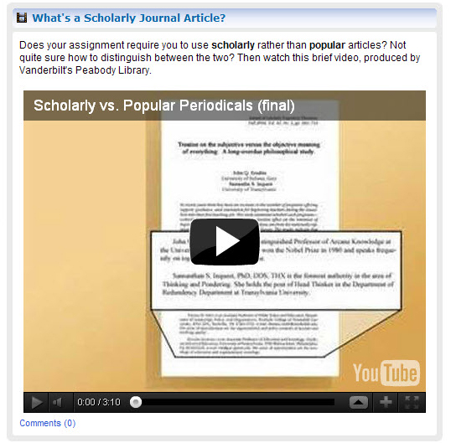
New Partnerships with University, Faculty, Research and Course Possibility
Revitalized Partnerships and Definitions for Library, Librarians and Faculty Central Library Relevance

Slide 29
Thank You For Coming
Questions?
Contact Information: Ray Uzwyshyn, Ph.D. M.L.I.S ruzwyshyn@gmail.com

